Slide 1
Chapter 15:
Characteristics, Applications & Processing of Polymers
ISSUES TO ADDRESS...
• What are the tensile properties of polymers and how
are they affected by basic microstructural features?
• Hardening, anisotropy, and annealing in polymers.
• How does the elevated temperature mechanical
response of polymers compare to ceramics and metals?
• What are the primary polymer processing methods?

Slide 2
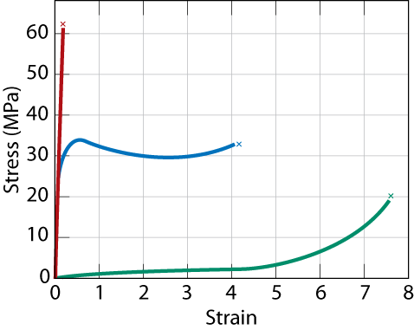
Mechanical Properties
i.e. stress-strain behavior of polymers
brittle polymer
σ_{FS} of polymer ca. 1-10% that of metals
plastic
elastomer
elastic modulus
– less than metal
Strains – deformations > 1000% possible
(for metals, maximum strain ca. 10% or less)

Slide 3
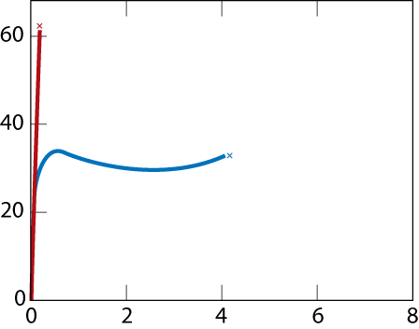
Tensile Response: Brittle & Plastic
σ
(MPa)
fibrillar structure
Near Failure
x
brittle failure
onset of
near
necking
failure
plastic failure
x
Initial
unload/reload
ε
aligned,
networked
cross-
case
crystalline
linked
regions
case
slide
semi-
crystalline
amorphous
crystalline
case
regions
regions align
elongate

Slide 4
Predeformation by Drawing
• Drawing…(ex: monofilament fishline)
-- stretches the polymer prior to use
-- aligns chains in the stretching direction
• Results of drawing:
-- increases the elastic modulus (E) in the
stretching direction
-- increases the tensile strength (TS) in the
stretching direction
-- decreases ductility (%EL)
• Annealing after drawing...
-- decreases alignment
-- reverses effects of drawing.
• Compare to cold working in metals!

Slide 5
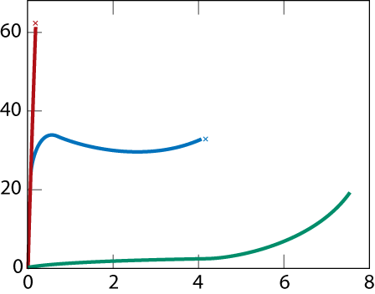
Tensile Response: Elastomer Case
σ
(MPa)
PPTA (Kevlar):
PE (Spectra):
σ~3 GPa=3000 MPa
x
brittle failure
x
plastic failure
x
elastomer
final: chains
ε
are straight,
still
cross-linked
initial: amorphous chains are
Deformation
kinked, cross-linked.
is reversible!
• Compare to responses of other polymers:
-- brittle response (aligned, crosslinked & networked polymer)
-- plastic response (semi-crystalline polymers)

Slide 6
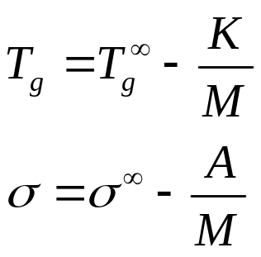
Thermoplastics vs. Thermosets
T
• Thermoplastics:
-- little crosslinking
-- ductile
-- soften w/heating
-- polyethylene
polypropylene
polycarbonate
polystyrene
Callister,
viscous
rubber
mobile
Fig. 16.9
T_{m}
liquid
liquid
tough
plastic
T_{g}
partially
crystalline
crystalline
solid
solid
• Thermosets:
-- large crosslinking
(10 to 50% of mers)
-- hard and brittle
-- do NOT soften w/heating
-- vulcanized rubber, epoxies,
polyester resin, phenolic resin
Molecular weight

Slide 7
T and Strain Rate: Thermoplastics
σ
(MPa)
• Decreasing T...
-- increases E
-- increases TS
-- decreases %EL
• Increasing
strain rate...
-- same effects
as decreasing T.
8
0
4°C
Data for the
semicrystalline
6
0
polymer: PMMA
20°C
(Plexiglas)
4
0
40°C
20
to 1.3
60°C
0
0
0.1
0.2
ε
0.3

Slide 8
Strength vs. Temperature
Amorphous
Semi-Crystalline
Yield
strength
Tg
Tm
Temperature

Slide 9
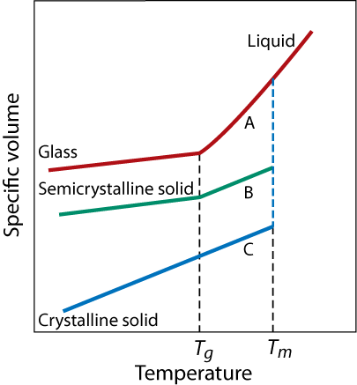
Melting vs. Glass Transition Temp.
What factors affect T_{m} and T_{g}?
Both T_{m} and T_{g} increase with increasing chain stiffness
Chain stiffness increased by
  Bulky sidegroups
  Polar groups or sidegroups
  Double bonds or aromatic chain groups
Regularity – effects T_{m} only
Usually Tg~0.7 Tm (in K)

Slide 10
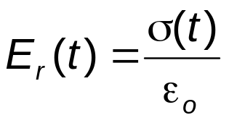
Time Dependent Deformation
• Stress relaxation test:
• Data: Large drop in E_{r}
for T > T_{g}.
-- strain to εο and hold.
-- observe decrease in
stress with time.
(amorphous
polystyrene)
10
5
rigid solid
E_{r} (10s)
(small relax)
in MPa
10
3
tensile test
transition
10
1
region
ε_{o}
strain
-1
10
viscous liquid
σ(t)
10
-3
(large relax)
time
60
100
140
180
T(°C)
T_{g}
• Relaxation modulus:
• Sample T_{g}(°C) values:
PE (low density)
PE (high density)
PP
PVC
PS
PC
- 110
90
35
+ 87
+100
+150

Slide 11
Time Dependent Deformation
• Stress relaxation test:
• Data: Large drop in E_{r}
for T > T_{g}.
-- strain to εο and hold.
-- observe decrease in
stress with time.
(amorphous
polystyrene)
10
5
rigid solid
E_{r} (10s)
(small relax)
in MPa
10
3
tensile test
transition
10
1
region
ε_{o}
crosslinked
strain
10
-1
viscous liquid
σ(t)
10
-3
(large relax)
time
60
100
140
180
T(°C)
T_{g}
• Relaxation modulus:
• Sample T_{g}(°C) values:
PE (low density)
PE (high density)
PP
PVC
PS
PC
- 110
90
35
+ 87
+100
+150

Slide 12
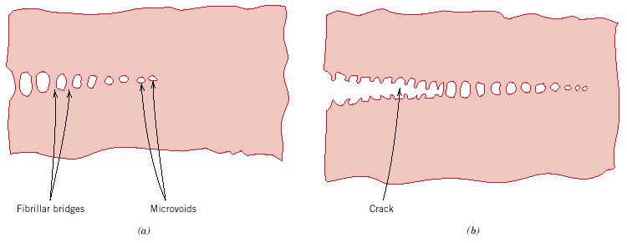
Polymer Fracture
Crazing ≅ Griffith cracks in metals
– microvoids and fibrillar bridges form
alligned chains
fibrillar bridges
microvoids
crack
Can be quite susceptible to certain solvents:
environmental stress cracking
Notes:
Note: crack spreads by breaking C-C bonds
Ductile plastics have large craze zones that absorb large amounts of energy as it spreads

Slide 13
Polymer Additives
Improve mechanical properties, processability, durability, etc.
Fillers
  Added to improve tensile strength & abrasion resistance, toughness & decrease cost
  ex: carbon black, silica gel, wood flour, glass, limestone, talc, mica, etc.
Plasticizers
  Added to reduce the glass transition
  temperature T_{g}
  commonly added to PVC - otherwise it is brittle
  potential issues with leaching, toxicity
Notes:
Polymers are almost never used as a pure material
Migration of plasticizers can be a problem

Slide 14
Polymer Additives
Stabilizers
  Antioxidants
  UV protectants
Lubricants
  Added to allow easier processing
  “slides” through dies easier – ex: Na stearate
Colorants
  Dyes or pigments
Flame Retardants
  Halogens Cl, F, Br; and B

Slide 15
Processing of Plastics
Thermoplastic –
  can be reversibly cooled & reheated, i.e. recycled
  heat till soft, shape as desired, then cool
  ex: polyethylene, polypropylene, polystyrene, etc.
Thermoset
  when heated forms a network
  degrades (not melts) when heated
  mold the prepolymer then allow further reaction
  ex: urethane, epoxy
Notes:
Can be brittle or flexible & linear, branching, etc.

Slide 16
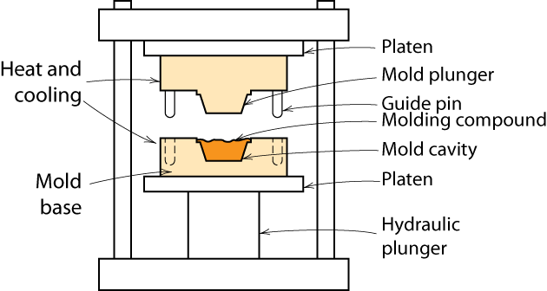
Processing Plastics - Molding
Compression and transfer molding
  thermoplastic or thermoset
Notes:
Male & female parts to mold

Slide 17
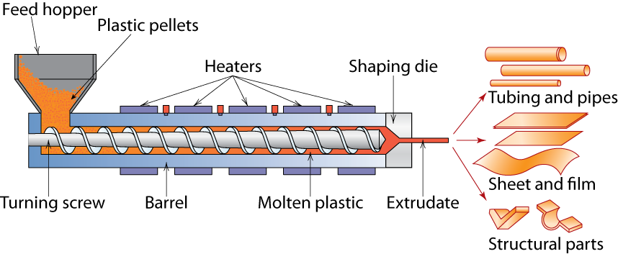
Processing Plastics – Extrusion
Notes:
An extruder is a device that used a large screw to melt a polymer, compress it, & force it into a mold
Extremely commonly used

Slide 18
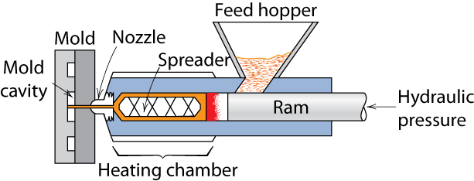
Processing Plastics - Molding
Injection molding
  thermoplastic & some thermosets
Notes:
Polymer is melted in chamber & then the molten polymer is forced under pressure into the die

Slide 19
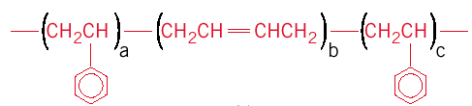
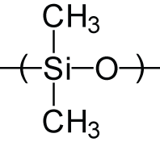
Polymer Types: Elastomers
Elastomers – rubber
Crosslinked materials
  Natural rubber
  Synthetic rubber and thermoplastic elastomers
    SBR- styrene-butadiene rubber
styrene
styrene
butadiene
– Silicone rubber

Slide 20
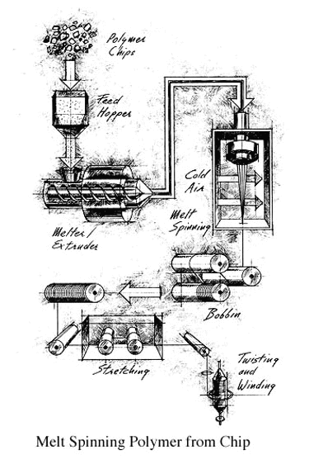
Polymer Types: Fibers
Fibers – have length/diameter >100
Textiles, reinforcements
Formed by spinning
  Extrude polymer through a spinnerette
  May be done from the melt, or from solution

Slide 21
Fiber spinning
Melt spinning
From the melt, only need to cool
Fastest, requires thermoplastics: PE, PP, PET, Nylons
Wet spinning
  From solution, coagulate in non-solvent
  Rayon (functionalized cellulose)
Dry spinning
  From solution, evaporate solvent
  MPDI (Nomex)
Dry-Jet Wet spinning
From liquid crystal solution
PPTA (Kevlar)
Gel spinning
  From a solidified (crystallized) dilute solution
  UHMWPE (Spectra)

Slide 22
Polymer Types
Coatings – thin film on surface – i.e. paint, varnish
  To protect item
  Improve appearance
  Electrical insulation
Adhesives – produce bond between two adherands
  Usually bonded by:
    Secondary bonds
    Mechanical bonding
Foams – gas bubbles in plastic
Films – blown film extrusion

Slide 23
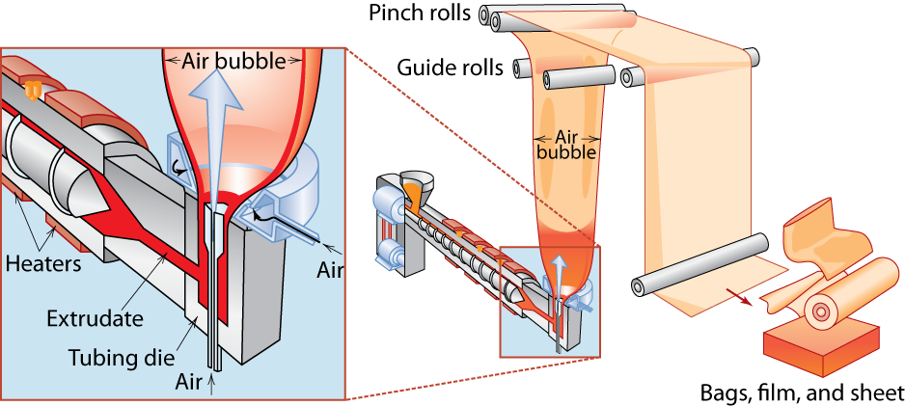
Blown-Film Extrusion

Slide 24
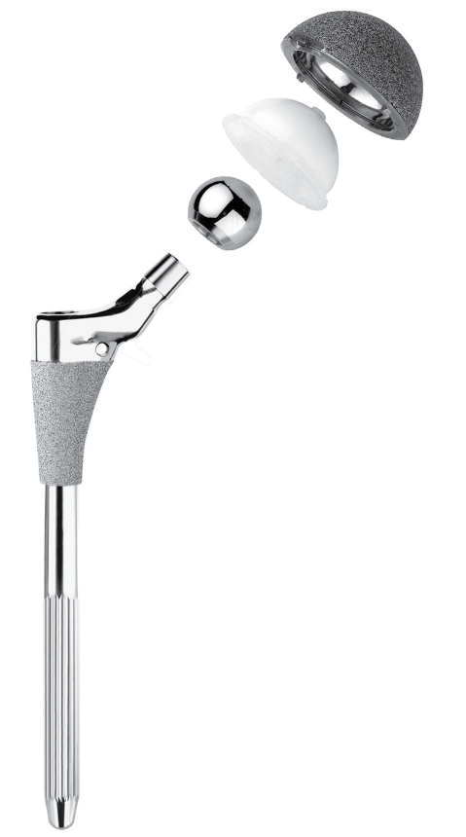
Advanced Polymers
Ultrahigh molecular weight polyethylene (UHMWPE)
  Molecular weight
  ca. 4 x 10⁶ g/mol
  Excellent properties for variety of applications
    Hip joints (wear resistance)
    Golf ball covers (as Surlyn ionomer)
    Bullet-proof fabric (as Spectra)
UHMWPE

Slide 25
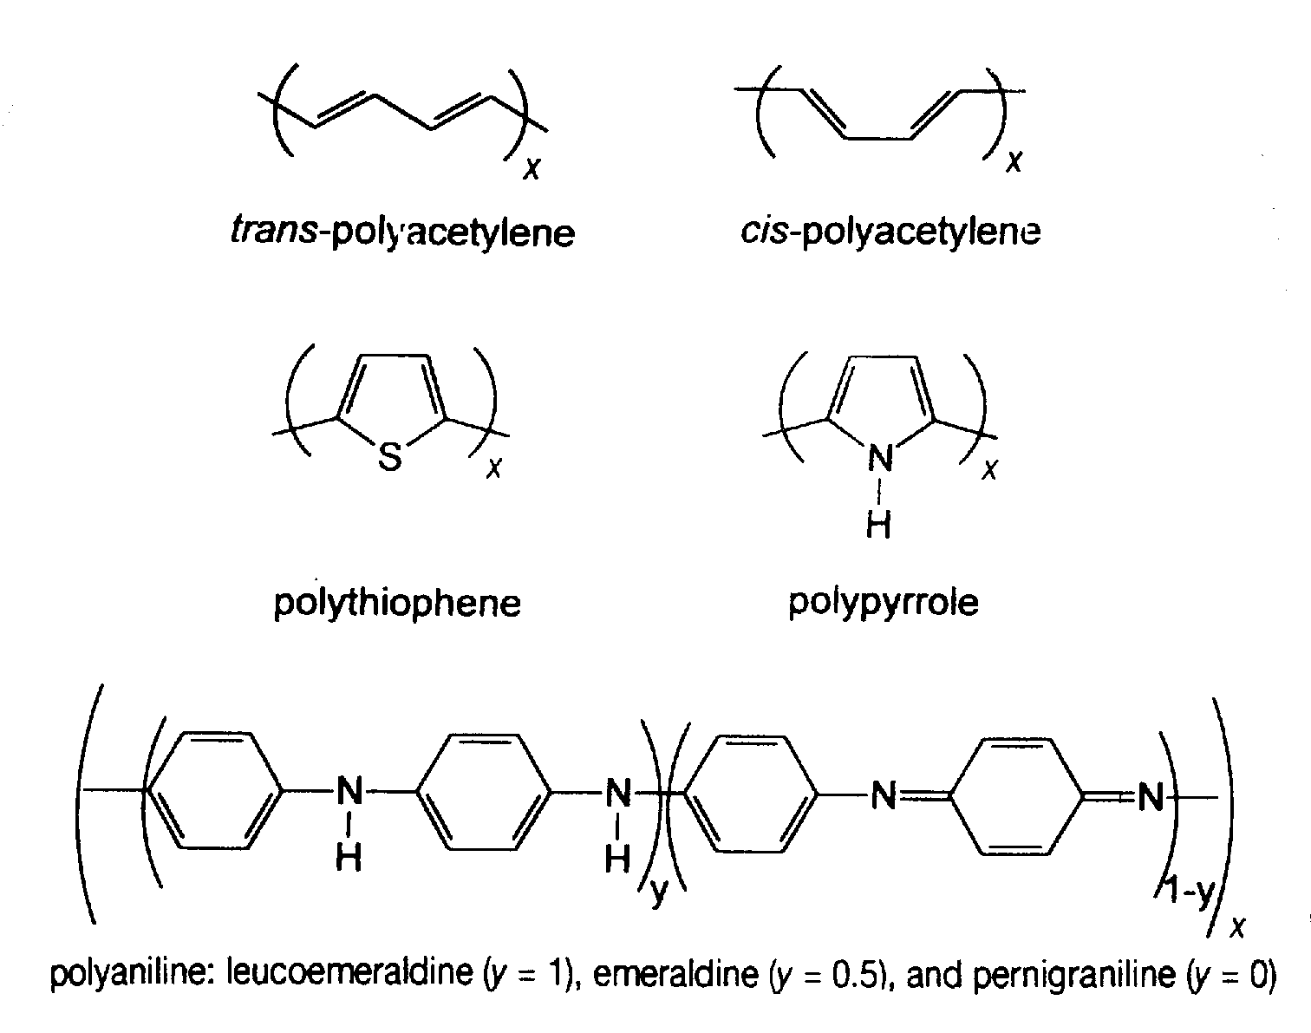
Conjugated, Conducting Polymers
Sensors
Actuators
Displays
Both electronic
and ionic
conduction

Slide 26
Summary
• General drawbacks to polymers:
-- E, σy, Kc, Tapplication are generally (but not always) small.
-- Deformation is often T and time dependent.
-- Result: polymers benefit from composite reinforcement.
• Thermoplastics (PE, PS, PP, PC):
-- Smaller E, σy, Tapplication
-- Larger Kc
-- Easier to form and recycle
• Elastomers (rubber):
-- Large reversible strains!
• Thermosets (epoxies, polyesters):
-- Larger E, σy, Tapplication
-- Smaller Kc

Slide 27
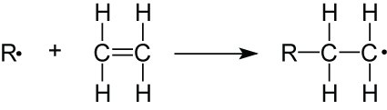
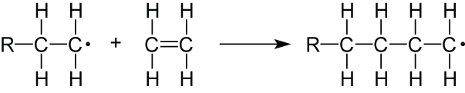
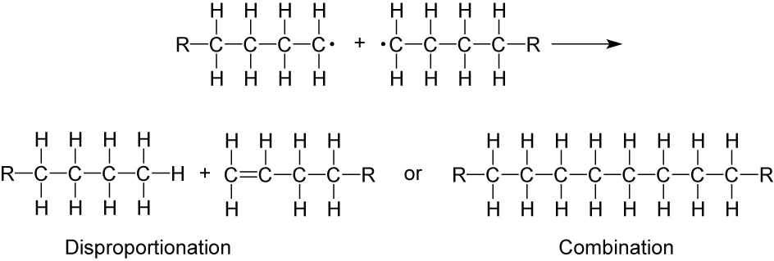
Addition (Chain) Polymerization
  Initiation
  Propagation
  Termination

Slide 28
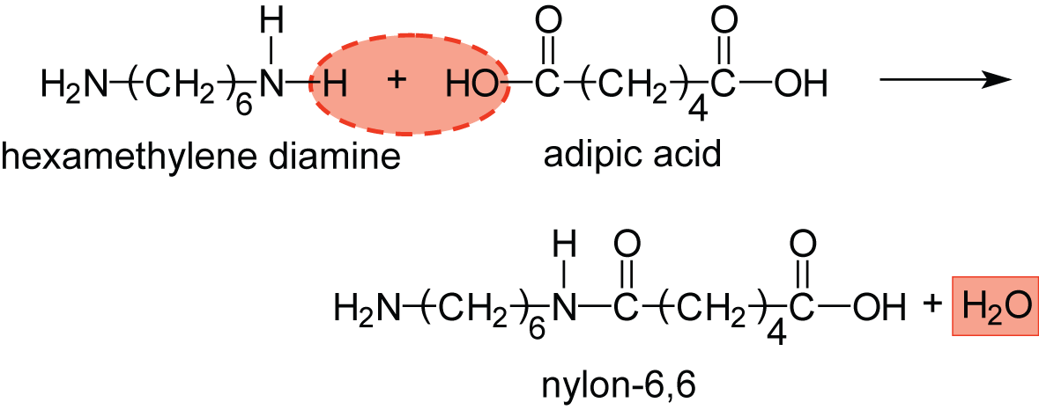
Condensation (Step) Polymerization

